Slide 1
1553 MEMORY BLOCK
BC RT

Slide 2
Motivation & Objective
Design of BC and RT Memory Management Subsystem for MIL-STD-1553
MIL-STD-1553 is a deterministic command/response serial bus.
Reliable data buffering and protocol control are critical.
Objective of this work:
Design BC and RT protocol control FSMs
Implement dedicated TX and RX memory buffers
Filter invalid or garbage data at protocol level
Provide a reusable memory management subsystem

Slide 3
Scope of Work
Implemented layers:
Protocol control (FSM)
Subaddress-based memory mapping
TX and RX buffering
Word count controlled transfers

Slide 4
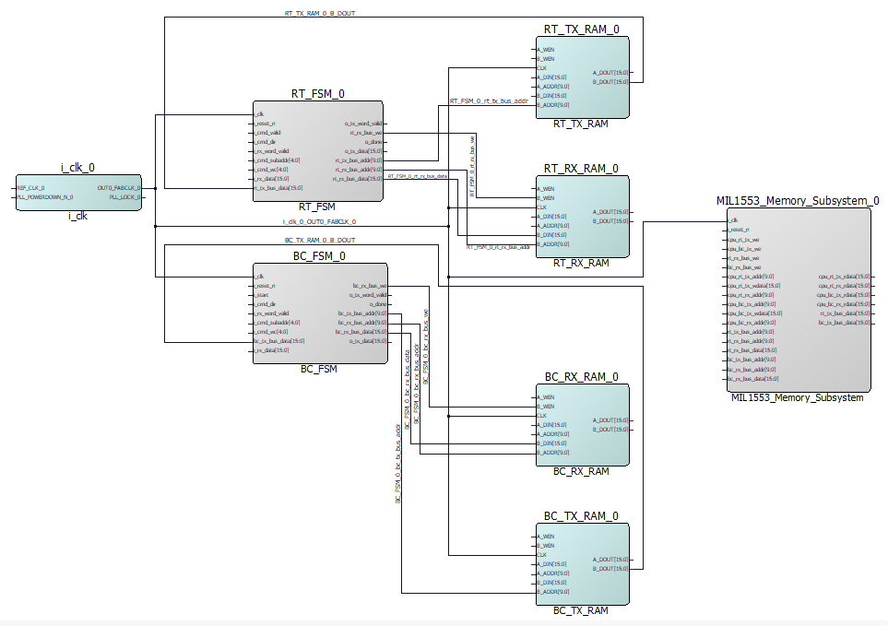
System Architecture

Slide 5
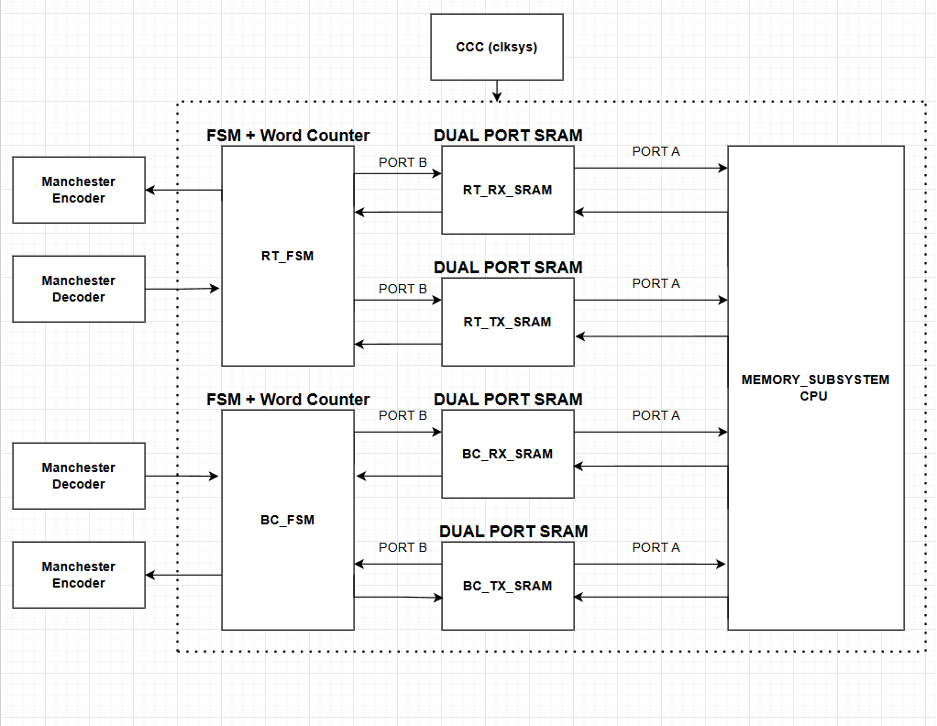
BLOCK DIAGRAM
Memory is used only for buffering
All communication is controlled by FSM

Slide 6
Memory Organization
Four dedicated dual-port SRAM blocks:
Memory Purpose
BC_TX_RAM Stores BC transmit data
BC_RX_RAM Stores data received by BC
RT_TX_RAM Stores RT transmit data
RT_RX_RAM Stores data received by RT
Key Features:
  Dual-port SRAM
  Port A: CPU side
  Port B: FSM side
  Separate TX and RX paths

Slide 7
Use of Dual-Port SRAM
Allows simultaneous access by:
CPU (software side)
FSM (protocol side)
Advantages:
No arbitration required
Deterministic timing
Clean separation of control and data
Simplifies system architecture

Slide 8
RT_FSM Overview
RT_FSM implements Remote Terminal protocol control:
Waits for decoded command
Extracts:
Direction
Subaddress
Word count
Controls two operations:
RX_ACTIVE → Receive data into RT_RX_RAM
TX_ACTIVE → Transmit data from RT_TX_RAM
States:
IDLE
RX_ACTIVE
TX_ACTIVE

Slide 9
RT_FSM Receive Path
When RX command is active:
Waits for i_rx_word_valid
On each valid word:
Writes data into RT_RX_RAM
Increments word counter
Stops when:
Word count reached
Key Feature:
Garbage data is filtered by writing only in RX_ACTIVE state.

Slide 10
RT_FSM Transmit Path
When TX command is active:
Reads data from RT_TX_RAM using:
address = base_addr + word_cnt
Drives transmit interface:
o_tx_data
o_tx_word_valid
Stops after required number of words
Special Case:
Word count = 0 interpreted as 32 words

Slide 11
RT_FSM Code Highlights
Subaddress Mapping:
base_addr <= resize(i_cmd_subaddr, 10) sll 5;
Word Count Handling:
if i_cmd_wc = 0 then
max_words <= 32;
else
max_words <= i_cmd_wc;
end if;
RX Write Control:
if i_rx_word_valid = '1' then
rt_rx_bus_we <= '1';
end if;
Explain:
Correct per 1553 standard
Protocol-level filtering implemented

Slide 12
Memory Subsystem Overview
The Memory Subsystem:
Instantiates 4 dual-port SRAM blocks
Connects:
  CPU to Port A
  FSM to Port B
Functions:
Provides dedicated TX and RX buffers
Allows concurrent CPU and FSM access
No arbitration logic required

Slide 13
Memory Access Pattern
Key Point:
TX memories are read-only by FSM
RX memories are write-only by FSM
Memory | Port A | Port B
RT_TX_RAM | CPU write | RT_FSM read
RT_RX_RAM | CPU read | RT_FSM write
BC_TX_RAM | CPU write | BC_FSM read
BC_RX_RAM | CPU read | BC_FSM write

Slide 14
Direct FSM-to-Memory Design
Each memory has only two masters:
CPU
One FSM
Dual-port SRAM already supports this
Therefore:
No arbitration required
No extra latency
Simple and robust design
In the proposed design, transmit memories are accessed by the FSM in read-only mode, while receive memories are accessed by the FSM in write-only mode. This enforces a clear separation between data sources and data sinks and prevents unintended memory corruption during protocol execution.

Slide 15
Garbage Data Filtering Mechanism
Filtering is done by FSM:
Write enable asserted only in valid states
Ignore RX data when:
No active command
Word count exceeded
Wrong direction
Result:
Memory contains only protocol-valid data
Improves system reliability

Slide 16
Clocking and Synchronization
Single system clock from PolarFire CCC
Drives:
BC_FSM
RT_FSM
All four SRAM blocks
Advantage:
Fully synchronous design
Deterministic timing
Simplified timing closure

